Slide 1

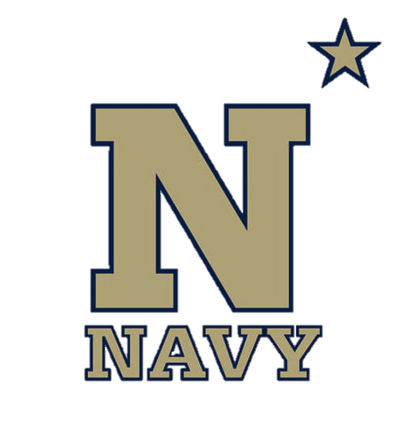
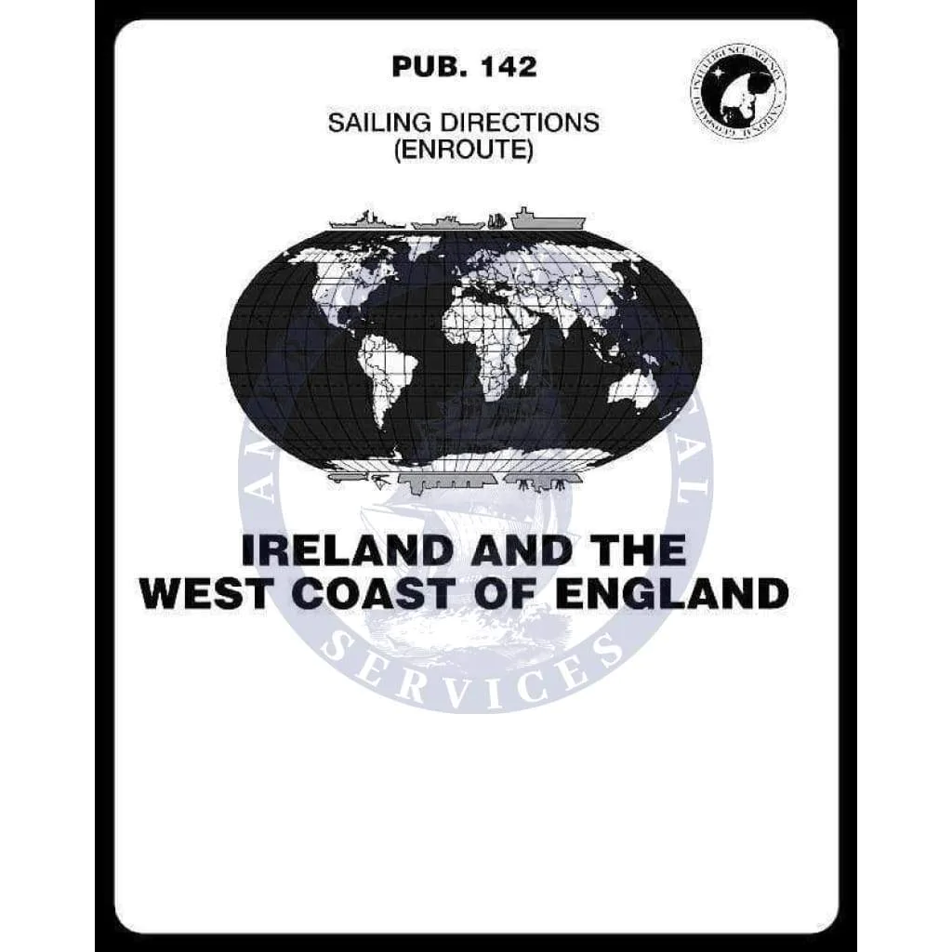
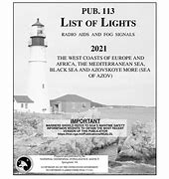
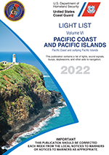
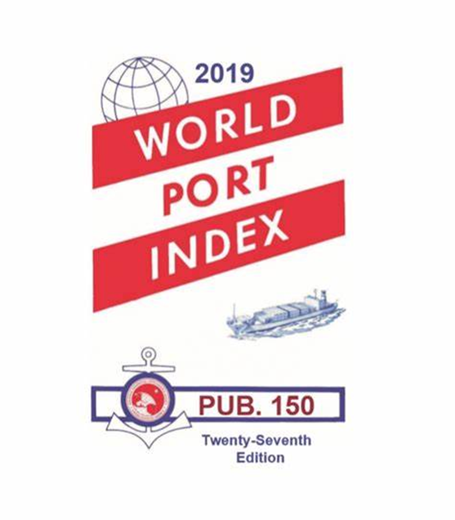
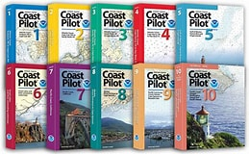
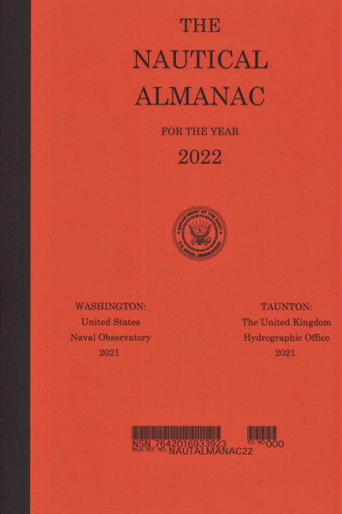
Nautical Publications
NN220-03
SEANAV I United States Naval Academy
NN220 – Fundamentals of Navigation– Updated Dec 22
Operations Officer I HMS PROTECTOR A173 I The Ice Patrol Ship

Slide 2
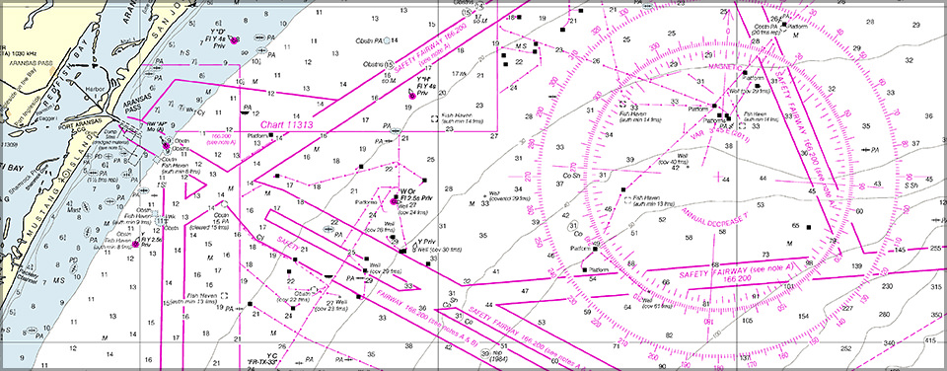
References
-The American Practical Navigator, Pub. No. 9, Bowditch, VOL. 1, 2019 Edition -Surface Ship Navigation Department Organizations and Regulations Manual (NAVDORM), COMNAVSURFPAC/COMNAVAIRPAC/COMNAVAIRLANT/COMNAVSURFLANT INSTRUCTION 3530.4 series
-U.S. Coast Pilots, -Sailing Directions, -Light List, -List of Lights, -NGA Radio Navigational Aids, Pub. No. 117 -Chart No. 1 -NGA World Port Index, Pub. No. 150 -NGA Distances Between Ports, Pub. No. 151 -Fleet Guide -NGA International Code of Signals, Pub. No. 102
SEANAV I United States Naval Academy
NN220 – Fundamentals of Navigation
Operations Officer I HMS PROTECTOR A173 I The Ice Patrol Ship

Slide 3
Enabling Objectives
1 – UNDERSTAND the NAVDORM requirements for publications onboard a surface naval vessel. 2 - DESCRIBE Sailing Directions, Sailing Directions Planning Guide and Sailing Directions Enroute. 3 - DESCRIBE U.S. Coast Pilots and know its difference from Sailing Directions. 4 - DESCRIBE the function of List of Lights and Light List and the difference between them. 5 - DESCRIBE the function of Fleet Guide. 6 - DESCRIBE NGA Radio Navigational Aids (PUB. 117) and its function. 7 - DESCRIBE the function of the Nautical Almanac. 8 - DESCRIBE the function of Distance Between Ports (PUB. 151). 9 - DESCRIBE NGA World Port Index (PUB. 150) and its function. 10 - DESCRIBE NGA International Code of Signals (PUB. 102) and its function. 11 - DESCRIBE Notice to Mariners and Local Notice to Mariners. 12 - DESCRIBE Navigation Rules and Regulations Handbook (Rules of the Road) and its function.
SEANAV I United States Naval Academy
NN220 – Fundamentals of Navigation
Operations Officer I HMS PROTECTOR A173 I The Ice Patrol Ship

Slide 4
Nautical Publications
-The navigator uses many textual sources to plan and conduct voyages. -These publications are available from a variety of sources. -Merchant and other civilian vessels will maintain the publications required by both local and international law. -These laws will also dictate which publications can be kept electronically and which ones must be kept as a hard copy -Surface ships in the US Navy have carriage requirements as dictated in the NAVDORM.
SEANAV I United States Naval Academy
NN220 – Fundamentals of Navigation
Operations Officer I HMS PROTECTOR A173 I The Ice Patrol Ship

Slide 5
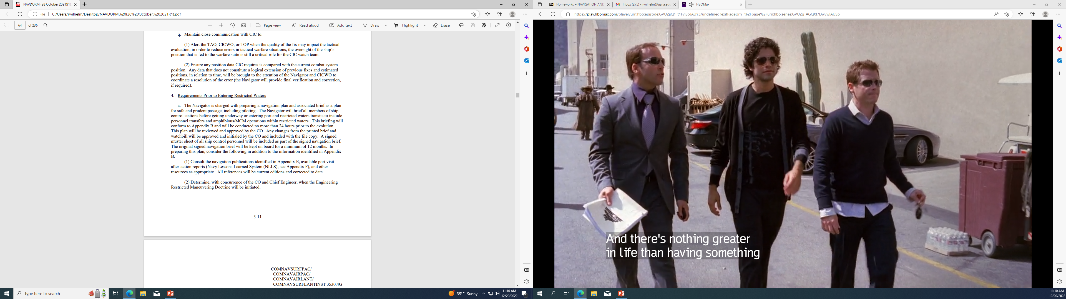
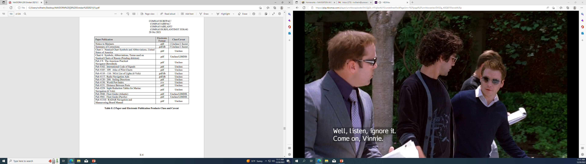
NAVDORM Requirements
SEANAV I United States Naval Academy
NN220 – Fundamentals of Navigation
Operations Officer I HMS PROTECTOR A173 I The Ice Patrol Ship

Slide 6
Nautical Publications
Port Information:
U.S. Coast Pilot
Sailing Directions
Fleet Guide
PUB150, World Port Index
Aids to Navigation:
Light List
List of Lights
PUB117, Radio Navigational Aids
Navigation:
Nautical Almanac
PUB151, Distances between Ports
Navigation Rules and Regulations
Miscellaneous:
Chart No. 1
Notice to Mariners
Local Notice to Mariners
PUB102, International Code of Signals
SEANAV I United States Naval Academy
NN220 – Fundamentals of Navigation
Operations Officer I HMS PROTECTOR A173 I The Ice Patrol Ship

Slide 7
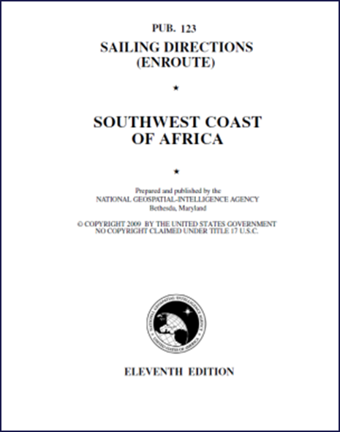
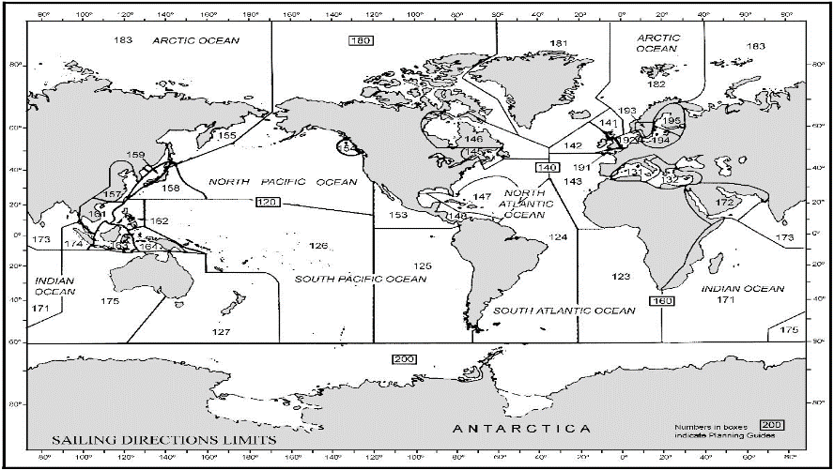
Sailing Directions
Sailing Directions (NGA)
NGA produces 37 Sailing Directions Enroutes
and 5 Planning Guides.
Enroutes detail coastal and port approach info.
Planning Guide provides describe general features
of ocean basins.
SEANAV I United States Naval Academy
NN220 – Fundamentals of Navigation
Operations Officer I HMS PROTECTOR A173 I The Ice Patrol Ship

Slide 8
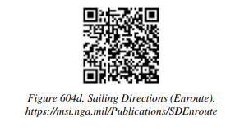
Sailing Directions
Sailing Directions Enroutes (NGA)
Organized geographically.
Provides information on wind, weather, tides,
currents, ice, dangers, navigational aids, procedures,
regulations and port facilities.
SEANAV I United States Naval Academy
NN220 – Fundamentals of Navigation
Operations Officer I HMS PROTECTOR A173 I The Ice Patrol Ship

Slide 9
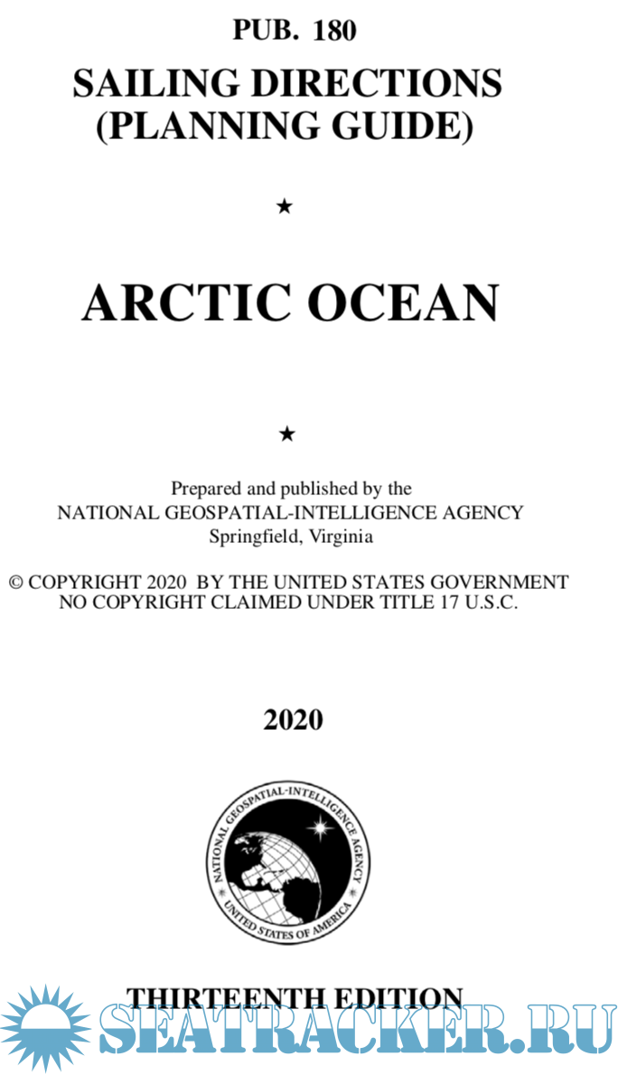
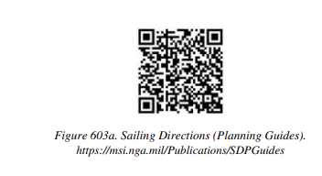
Sailing Directions
Sailing Directions Planning Guide (NGA)
Used in planning extensive oceanic voyages
Relatively static.
Structured alphabetically by country within the region.
SEANAV I United States Naval Academy
NN220 – Fundamentals of Navigation
Operations Officer I HMS PROTECTOR A173 I The Ice Patrol Ship

Slide 10
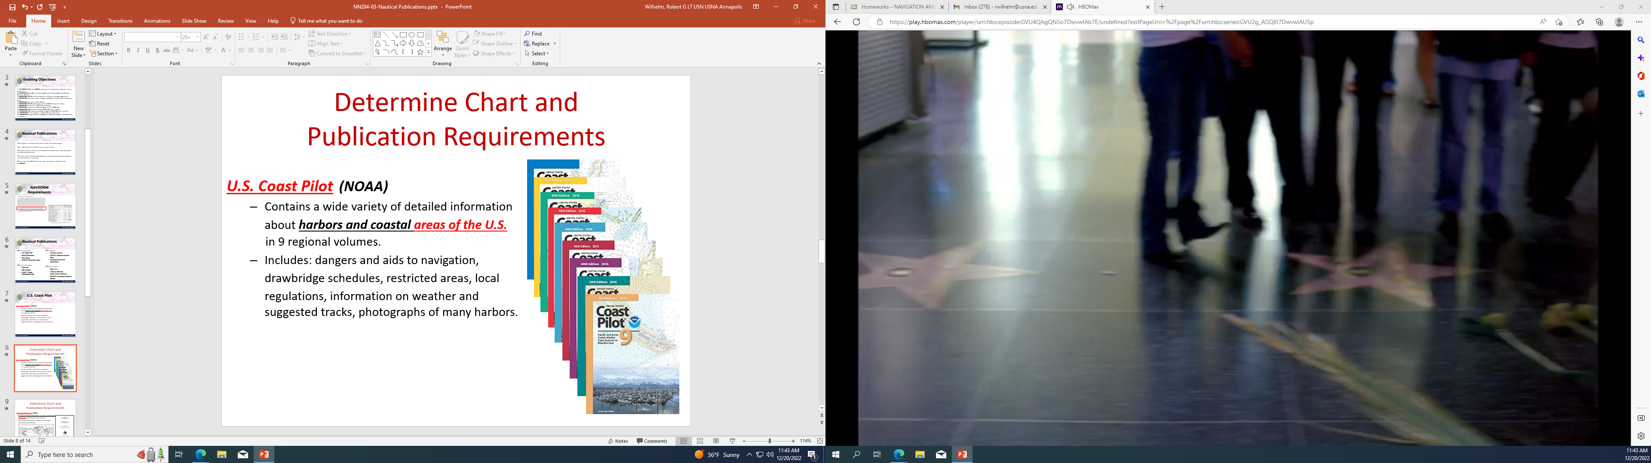
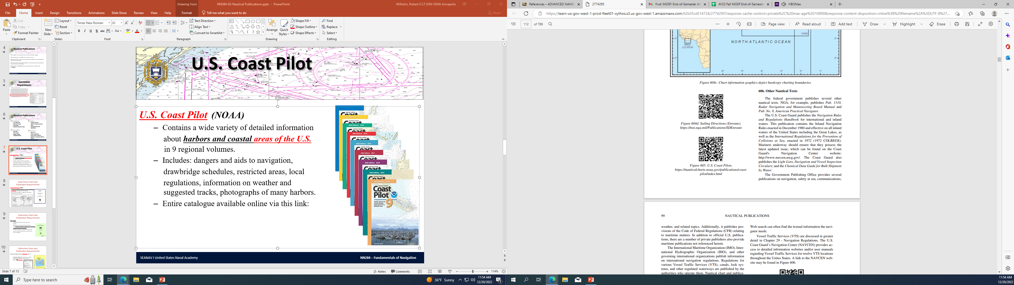
U.S. Coast Pilot
U.S. Coast Pilot (NOAA)
Contains a wide variety of detailed information
about harbors and coastal areas of the U.S. in 9 regional volumes.
Includes: dangers and aids to navigation,
drawbridge schedules, restricted areas, local
regulations, information on weather and suggested tracks, photographs of many harbors.
Entire catalogue available online via this link:
SEANAV I United States Naval Academy
NN220 – Fundamentals of Navigation
Operations Officer I HMS PROTECTOR A173 I The Ice Patrol Ship

Slide 11
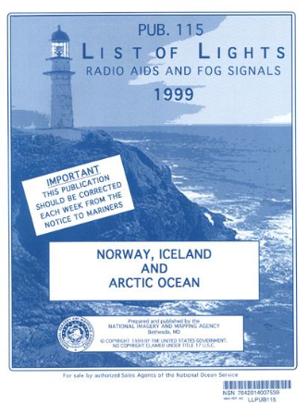
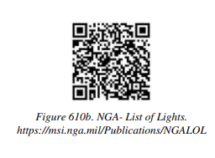
List of Lights
List of Lights (NGA)
Contains a summary of all lights, sound signals, buoys,
beacons and other aids to navigation for international
waters.
SEANAV I United States Naval Academy
NN220 – Fundamentals of Navigation
Operations Officer I HMS PROTECTOR A173 I The Ice Patrol Ship

Slide 12
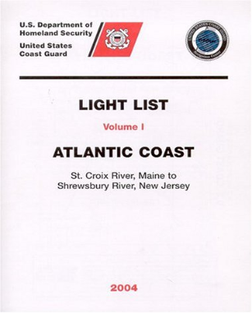
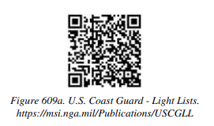
Light List
Light List (USCG)
Contains a summary of all lights, sound signals, buoys,
beacons and other aids to navigation in U.S. waters.
SEANAV I United States Naval Academy
NN220 – Fundamentals of Navigation
Operations Officer I HMS PROTECTOR A173 I The Ice Patrol Ship

Slide 13
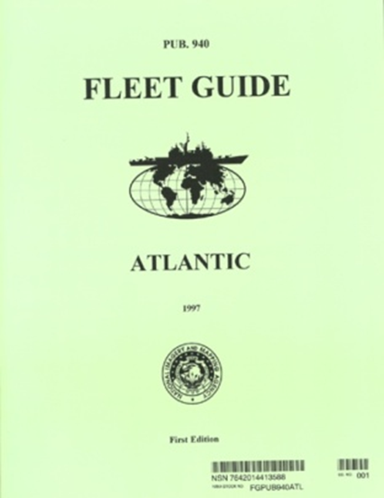
Fleet Guide
Fleet Guide (NGA)
Available only for ports with major naval
facilities
Designed to acquaint incoming naval ships
with pertinent command, navigational, operational,
repair and logistics information
CD-ROM versions even have short videos and
pictures of harbor approaches and prominent
aids to navigation
SEANAV I United States Naval Academy
NN220 – Fundamentals of Navigation
Operations Officer I HMS PROTECTOR A173 I The Ice Patrol Ship

Slide 14
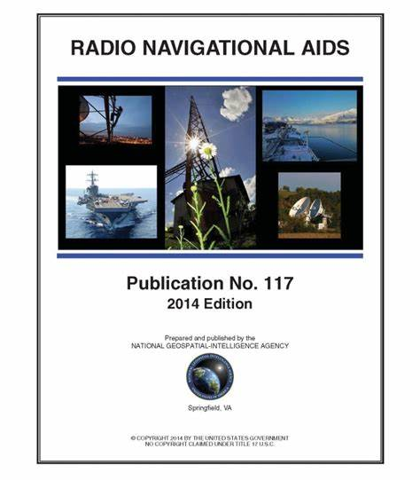
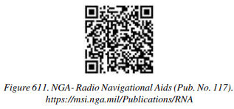
PUB. No. 117
Radio Navigational Aids
Radio Navigational Aids (NGA)
Selected list of worldwide radio stations which
provide services to mariners.
Topics include vital communication services,
RADAR stations, radio navigation warnings and
long range navigation aids.
SEANAV I United States Naval Academy
NN220 – Fundamentals of Navigation
Operations Officer I HMS PROTECTOR A173 I The Ice Patrol Ship

Slide 15
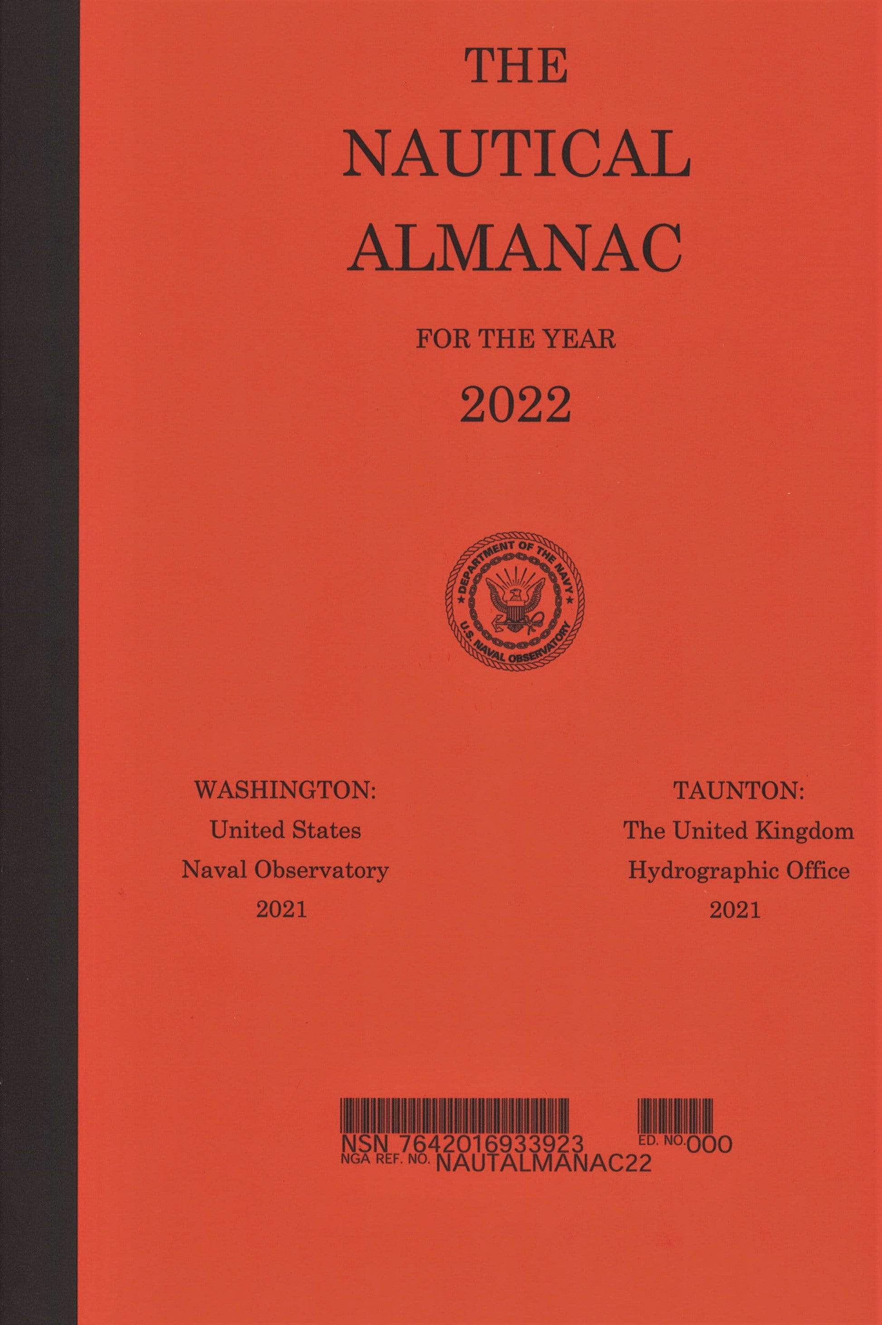
Nautical Almanac
Nautical Almanac
Publication needed to conduct celestial observations
and sight reductions.
Contains information on Sunrise, Sunset, Moonrise,
Moonset and compact sight reduction tables.
Produced annually by the USNO and the UKHO.
SEANAV I United States Naval Academy
NN220 – Fundamentals of Navigation
Operations Officer I HMS PROTECTOR A173 I The Ice Patrol Ship

Slide 16
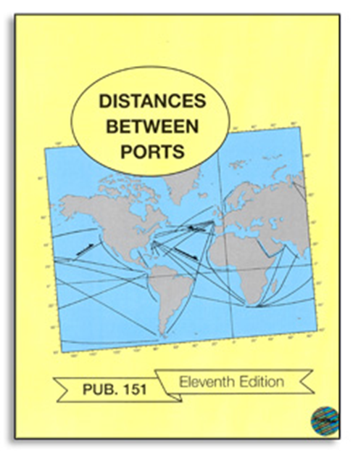
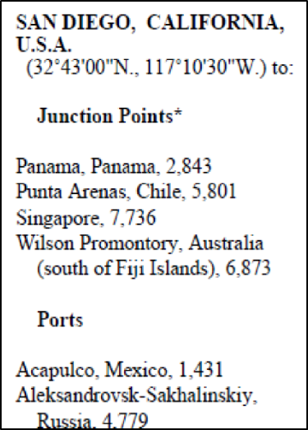
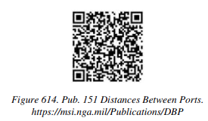
PUB. 151
Distances Between Ports
Distances Between Ports (NGA)
Calculates distances between ports and/or
major junction points around the world.
(Based on Great Circle.)
SEANAV I United States Naval Academy
NN220 – Fundamentals of Navigation
Operations Officer I HMS PROTECTOR A173 I The Ice Patrol Ship

Slide 17

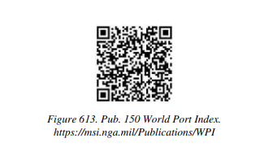
PUB. 150
World Port Index
World Port Index (NGA)
Listing of thousands of ports around the world.
Describes location, characteristics, facilities and
services available.
Arranged alphabetically.
SEANAV I United States Naval Academy
NN220 – Fundamentals of Navigation
Operations Officer I HMS PROTECTOR A173 I The Ice Patrol Ship

Slide 18
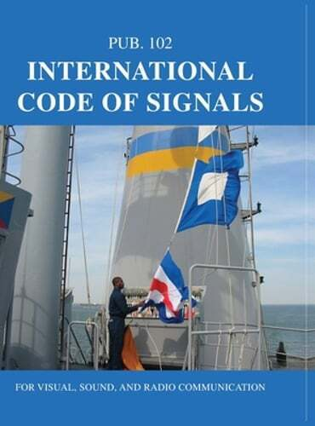
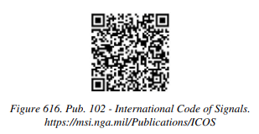
PUB. 102
International Code of Signals
International Code of Signals (NGA)
Listing of signals employed by vessels to
communicate.
Signals can be transmitted by lights, morse
code, sounds, semaphore flags and telephone.
SEANAV I United States Naval Academy
NN220 – Fundamentals of Navigation
Operations Officer I HMS PROTECTOR A173 I The Ice Patrol Ship

Slide 19
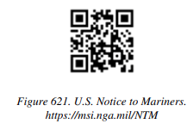
Notice to Mariners
Notice to Mariners (NGA)
Published weekly and prepared jointly by NGA and NOAA.
Applies to nautical charts and publications.
Advises mariners of important matters affecting navigational safety, including dangers to navigation, new hydrographic information, changes to aids to navigation, and more.
Responsibility of the user to determine which of their charts or publications require updates.
SEANAV I United States Naval Academy
NN220 – Fundamentals of Navigation
Operations Officer I HMS PROTECTOR A173 I The Ice Patrol Ship

Slide 20
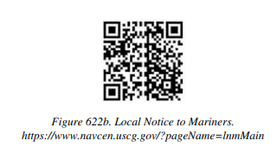
Local Notice to Mariners
Local Notice to Mariners (USCG)
Issued by each USCG district to disseminate information affecting navigational safety in their district.
Reports changes and deficiencies in aids to navigation maintained by USCG.
Other info such as new charts, channel depths, naval operations and regattas are included.
SEANAV I United States Naval Academy
NN220 – Fundamentals of Navigation
Operations Officer I HMS PROTECTOR A173 I The Ice Patrol Ship

Slide 21
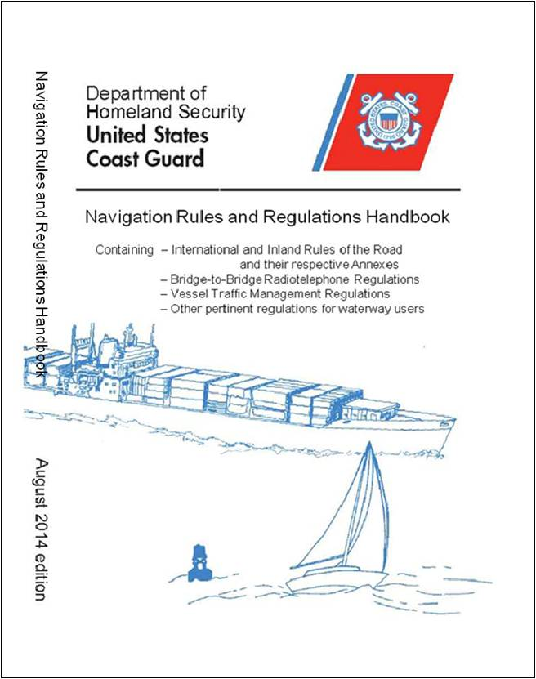
Navigation Rules and Regulations Handbook
Navigation Rules and Regulations Handbook(USCG)
Produced by the USCG.
Rules based on the Convention on the International Regulations for Preventing Collisions at Sea, 1972 (COLREGS).
Congress adopted them as the International Navigation Rules Act of 1977.
All U.S. flagged vessels must adhere to the rules.
Covers international and inland rules.
SEANAV I United States Naval Academy
NN220 – Fundamentals of Navigation
Operations Officer I HMS PROTECTOR A173 I The Ice Patrol Ship

Slide 22
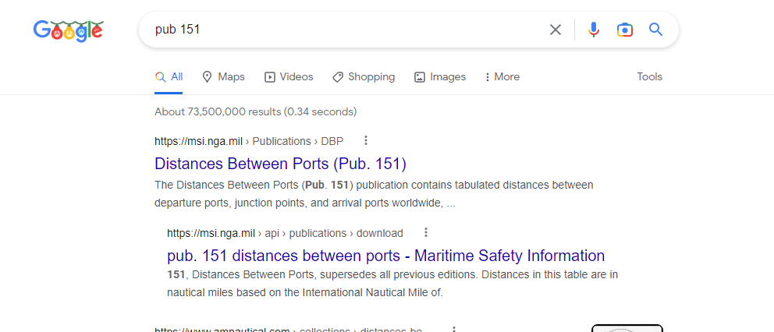
Where to find publications
-Most of these publications are available free online. -A simple Google search can help you find everything you need. -These publications will be needed as we continue the course.
SEANAV I United States Naval Academy
NN220 – Fundamentals of Navigation
Operations Officer I HMS PROTECTOR A173 I The Ice Patrol Ship

Slide 23
Enabling Objectives
1 – UNDERSTAND the NAVDORM requirements for publications onboard a surface naval vessel. 2 - DESCRIBE Sailing Directions, Sailing Directions Planning Guide and Sailing Directions Enroute. 3 - DESCRIBE U.S. Coast Pilots and know its difference from Sailing Directions. 4 - DESCRIBE the function of List of Lights and Light List and the difference between them. 5 - DESCRIBE the function of Fleet Guide. 6 - DESCRIBE NGA Radio Navigational Aids (PUB. 117) and its function. 7 - DESCRIBE the function of the Nautical Almanac. 8 - DESCRIBE the function of Distance Between Ports (PUB. 151). 9 - DESCRIBE NGA World Port Index (PUB. 150) and its function. 10 - DESCRIBE NGA International Code of Signals (PUB. 102) and its function. 11 - DESCRIBE Notice to Mariners and Local Notice to Mariners. 12 - DESCRIBE Navigation Rules and Regulations Handbook (Rules of the Road) and its function.
SEANAV I United States Naval Academy
NN220 – Fundamentals of Navigation
Operations Officer I HMS PROTECTOR A173 I The Ice Patrol Ship

Slide 24
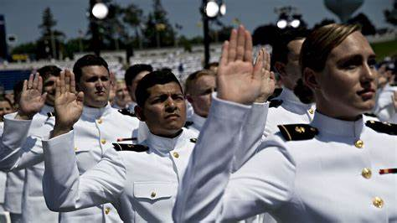
Questions?
SEANAV I United States Naval Academy
NN220 – Fundamentals of Navigation
Operations Officer I HMS PROTECTOR A173 I The Ice Patrol Ship

